Slide 1
Business Economics
Marcelo Ortiz M.

Slide 2
Topic 6: Incentive Compensation
Objectives:
1) understand the role of compensation in the incentive problem
2) understand ownership as a solution mechanism
3) list the associated factors that favor high-incentive pay
4) define the informativeness principle

Slide 3
The basic incentive problem
Timeline of the contract:
Time | Event
t=0 | Contract is designed: F(output)=compensation
t=1 | Contract is offered (and potentially accepted)
t=2 | Employee exerts effort
t=3 | Employee is compensated

Slide 4
The basic incentive problem
Let’s consider the following case of designing a compensation contract
  Preferences of an employee with respect the income (I) and effort (e) are measured as working hours:
  U(I,e)=I-e²
  Reservation utility = $1.000 (the company must meet this level, or the employee will not work for the firm.)
  B(e)=$100e: the revenues for the firm driven by the employee’s effort choice e.
  Big assumption: effort is costlessly observable and verifiable, so the effort is contractible.
    In this case, the contract offers a sum of money if and only if the employee provides a specified level of effort
    The sum of money must be at least the reservation utility
    So the contract must provide the following compensation scheme:
    Thus, firm’s profit is:

Slide 5
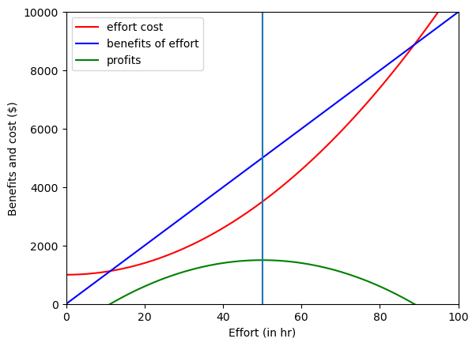
The basic incentive problem
The firm will chose the optimal effort that maximizes its profit
The optimal compensation contract sets effort in e*=50 hrs.
-Salary*=1000+50^2=$3.500.
-Firms profit*=$1.500.
-Utility=3.500-50^2=$1.000.

Slide 6
The basic incentive problem
This solution is not feasible in real life:
  The output is not observable and can be affected by external factors beyond the employee’s control.
So if the effort is not contractable, how can the employee promise to provide 50 hrs of effort?
  The employee can stay at the office for 50 hrs but working less efficiently (whatsapp!)
  Why might a company pay him a fixed salary of $3.500 if he has the incentive to renege on his promise and provide less effort?
The company can suspect it but would not know for sure.
So what type of contract solves this incentive problem?

Slide 7
The basic incentive problem
This simple example illustrates three important points
  1) if employees and employers have perfectly aligned interests, there is no reason to worry about incentives.
  2) incentive problems are not problematic when actions are contractible/verifiable.
  3) in a competitive labor market, employees must be compensated for undertaking undesirable actions

Slide 8
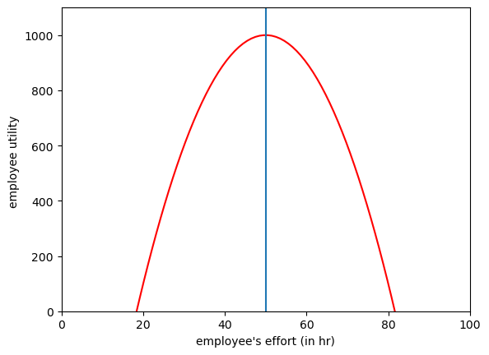
Incentives from ownership
The incentive problem arises because employees bear the costs of exerting effort while much of the gains go to the owners… why not sell employees their output?
  Both cost and benefits are internalized by employees → better incentive coordination
Example cont: the firm could sell the employee the rights to the value of his output ($100e) at the price of $1.500 (= firms profits!)
  The employee objective function (eg., personal utility) is
  The employee thus will exert 50 hrs of effort and get the same utility of $1.000.
  The same outcome as in the perfect information case, but it’s achieved even though the employer cannot observe effort

Slide 9
Incentives from ownership
Most of the empirical evidence indicates that managers operate units better after they become owners
However, there are some limitations to this solution
  Wealth constraints: agent does not have enough personal capital
  Risk aversion
  Team production: synergies and identification of separate contributions, free-rider problem

Slide 10
Optimal risk sharing
Now let focus on the risky nature of the output
Making the compensation “output-sensitive” brings risk into the agent’s income
Risk aversion: holding expected income constant, the agent prefers less dispersion in outcomes.

Slide 11
Optimal risk sharing
Risk-averse individuals are better off when they reduce the volatility of their income
However, people differ in their attitudes toward risk.
Even within the same profession: age, health condition, personality, reputation.

Slide 12
Optimal risk sharing
Ownership of companies is usually in hands of diversified owners/investors.
  Because they can diversify their risky income, they care less about firm-specific revenues
In contrast, employees have a large fraction of their income in one job.
  They are not well-diversified, so they care more about firm-specific revenues
So, employees have less effective methods (or knowledge) to manage firm-specific risk.
  This means that they will bear that risk at a higher price relative to the shareholders
  Therefore, from a risk-sharing standpoint, it’s better to pay employees a fixed salary and avoiding to output-sensitive compensation for risk-bearing to attract and retain risk-averse employees.

Slide 13
Effective Incentive Contracts
At this point, it should be clear that compensation contracts serve as
  1) motivation mechanism to induce effort
  2) risk-sharing agreement
But as we have seen, each of these goals leads us to different types of contracts.
  1)motivation: less fix salary more output-sensitive compensation
  2)risk-sharing: more fix salary and less output-sensitive compensation
So we need to find an efficient trade-off: the effective incentive contract.
Relevant inputs come from the moral hazard model.
  With no math.
  If you want to check the math, look Section 1: https://marceloortizm.com/lecture_accounting_theory/mora_hazard.html

Slide 14
The efficient contract: factors for output-sensitive comp.
1) The value of output is sensitive to the employee’s effort
  Salesforce, customer service
2) The employee is not very risk-averse
  Age, background culture
3) The risk beyond the employee’s control is low
  Sport couch, tourism
4) Employee’s response to increased incentives is high
  How much sales would increase if we offer employees a bonus equals 1% of sales?
5) The employee’s output can be measured at a low cost
  With salesforce it is easy, but what about R&D or brand building?

Slide 15
Summary
Rewarding employee’s risk exposure
+
  Fixed payment per unit of Q
Larger fixed payment per unit of Q
Q’s observability
Adding effort incentives
(bonuses/ownership)
Larger fixed payment per unit of Y + output-sensitive comp.
Fixed payment per unit of Y + output-sensitive comp.
-
-
Q’s risk
+
Notice that if “Q=risk” (just a lottery) there is no need hire anyone.

Slide 16
Summary 1
Q’s observability
Case 1: employee’s Q is observable and not risky, then the contracting problem is simple because Q can be incorporated in the contract.
  -Contract: fixed payment per unit of output Q.
Examples:
  Hair salon’ owner and hairdressers: $ 10 euros per haircut (of course, the total month salary is variable in the number of haircuts.)
Case 2: employee’s Q is not observable and not risky, then Q cannot be written down in the contract, and then the contract needs to induce effort.
  - Y is a proxy for Q (connection with topic 6: gaming)
  - Contract: fixed payment per unit of Y + output-sensitive comp. (e.g., bonus per Annual Y)

Slide 17
Summary 2
Q’s risk
Case 3: employee’s Q is not observable and risky:
Q=productivity*e+risk
(Important: even though risk could be high, Q still depends on the employee’s effort)
  - Contract 1: $75 fixed
  - Contract 2: $50 fixed + ($0 if output is low or $50 if output is high)[probabilities conditional on effort: 50%]
- In expectation, both contracts lead to the same payment, so a risk-neutral employee would pick either.
  - However, if the employee is risk averse, then she picks Contract 1.
- Therefore, if the company wants the employee to sign the 2nd contract, it has to compensate the employee’ risk exposure by increasing the fixed component in the salary.
  - For example: Contract 2’: $65 fixed + ($0 if output is low or $50 if is high)
Conclusion: the higher the Q’s risk or employee’s risk aversion are, the larger the risk-compensation by increasing the fixed component.

Slide 18
Summary
Main concepts
  Outcome/effort observability
  Risk aversion and risk sharing
  Efficient contract
  Compensation

Slide 19
Cases to Discuss
Present an real case related to some of the topics of the class.
  The case should be based on recent news (<2 years) and preferably related to Spanish companies/cases.
  Start the presentation with the context behind the event/decision/case, then identify the relevant concepts, to finally conclude/assess the case.
  10 min, 7-11 slides
  Examples:
    1) ownership mechanism: stock compensation programs in Spain/EU
    2) are US CEOs overpaid relative to European CEOs? Compare similar size/industry firms
    3) how technology have improved outcome measurement, and the implications for salaries.
    4) alternative methods for increasing employee’s utility different that monetary compensation.

